Slide 1
Good morning!!!
We’ll start at 10:00am. Until then, make yourself comfortable!
If you don’t already have a Microsoft Account, get one here: account.microsoft.com
All the exercises will be performed on your own device in a web browser.

Slide 2
Web Development Fundamentals 2
January 2020
Microsoft Reactor | San Francisco
#ReactorSanFrancisco

Slide 3
Presenter’s Name
Title goes here

Slide 4
Workshop Agenda
10:00 am | Introduction to Web Development Keynote
10:30 am | Part 1. HTML: Programming the Web
11:00 am | Part 2.: CSS: Selectors, Styling, and Display
12:00 pm | Lunch + Survey
12:30 pm | Part 3. JavaScript
1:00 pm | Part 4. jQuery + APIs
1:30 pm | Part 5. Capstone Project + Deployment with Azure
3:45 pm | Wrap Up and Next Steps
Notes:
|

Slide 5




developer.microsoft.com/reactor/
@MSFTReactor on Twitter
Notes:
Welcome to your <location> Microsoft Reactors. We are worldwide local community spaces where developers and startup leaders meet, learn, and connect. Reactors build a diverse community by providing training, learning paths, industry speakers, and seminars, plus meetups and other community events related to emerging technology trends.
Reactor learning, networking, and leadership opportunities are designed to focus on real-world challenges to enable members of the tech community to stay up to date and drive solutions. Reactors are a place to share knowledge and expand impact in the company of technology enthusiasts locally and globally.
We have workshops and other learning opportunities planned throughout the year. Or if you want to host your own event at a Reactor, you can make the request on our website.

Slide 6

Notes on Learning How to Learn
The “Cycle of Learning”
Know why you are learning something.
Work in short highly active and focused periods.
Take a break
Review what just learned before starting something new.
Make connections
Write our experiences to our long-term memory
Concept
Concept
Concept
Your Brain
Notes:
Here’s how we will be working through the workshop today.
1. We will go through each section by starting with why we are learning a specific topic and section, I start by giving a high level overview of the materials we are covering and how this content fits into the big picture.
2. When we work, we work short periods of time with high concentration and intensity. With few distractions.
3. After we’ve finished a section we will take a break.
4. Before we start on new material we will review the material that we just covered.
a. While we are reviewing we need to make connections. We should connect and think about the new concepts we are learning and connect them to old concepts.
b. By making connections and associating data with other data that we are familiar with, we retain the things we learn better.
c. Our brains are giant classification modeling engines.

Slide 7

Web Development Facts: 2020
4,437,215,927 (1/5/2020) Internet Users around the world. (up from 3.42 billion in 2016)
There are 326,474,013 people in the United States, and nearly double that using the internet in China, which has a population of 1,415,045,928.
How many websites are there in 2020? As of January 2020 there were over 1.74 billion websites on the Internet. info.cern.ch was the first-ever website on the Internet, published on August 6, 1991
Approximately 40% of the world’s population had an internet connection in 2018. In 1995, it was less than 1%.
In Asia, China reigns supreme when it comes to having the most active internet users. With 818,934,000 users, the next closest countries include the United States with 320,059,368, Russia with 109,552,842, and Latin America/Caribbean with 18,526,199 users.
Takeaway: The Web is a thriving place, and web developers are needed.
US News and World Reports classify Web Developers as:
#3 Best Technology Jobs
#13 Best STEM Jobs
#23 in best 100 Jobs
Notes:
Web development is the umbrella term for conceptualizing, creating, deploying and operating web applications and APIs (Application Programming Interfaces) for the Web.
The Web has grown a mindboggling amount in the number of sites, users and implementation capabilities since the first website went live in 1991. Web development is the concept that encompasses all the activities involved with websites and web applications.
As a career, web developers are still in high demand, with specializations in web development for mobile apps, data science, and websites emerging weekly.
https://www.websitehostingrating.com/internet-statistics-facts/

Slide 8
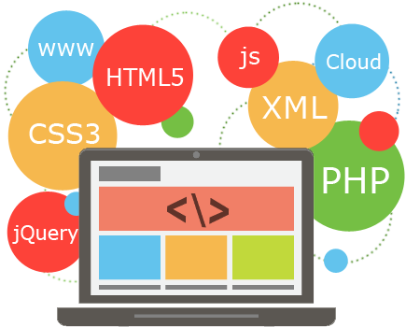
Types of Web Developers
1. Front end developers
2. Back end developers
3. Full stack developer
Notes:
1. Front end developers — one who develops the website and the visuals using HTML, CSS and JavaScript.
2. Back end developers — one who develops the actions on a website or web apps using programming languages like Ruby, Python, Php etc.
3. Full stack developer — one who can develop all layers of the software
Some people also include debuggers and researches in this list.
Developers can also be categorized according to their style of work -
· one who sticks to traditional rules
· one who uses libraries and frameworks
· one with multiple programming language
· one with artistic nature
We also have developers that work in DevOps, MicroServices, and other sub niches of the development industry.

Slide 9



Azure for Web Development
Visual Studio
Visual Studio Code
Unified SDKs
PHP
Go
Java
Python
.NET
Javascript
Cloud Based Tools
Azure Productivity Tools:
Cloud Explorer
Azure Watch
Azure Ping
Cloud Combine
Azure Data Tools
Many more…
Notes:
Microsoft offers a comprehensive set of development tools for any developer—using any platform or language—to deliver cloud applications. Code with the language of your choice using a range of SDKs and take advantage of full-featured integrated development environments (IDEs) and editors with advanced debugging capabilities and built-in Azure support.

Slide 10
The Rise of the Web Developers
Desktop/Laptop computers give us the power to develop web-based applications
Technologies:
Cloud Services
Javascript Engines built into browsers
IP/TCP – Standardized Protocols
Networking Equipment
Fiber Optics
Satellite data transfer
Notes:
Over the past two decades, web development has emerged as a profession due to the fact that we have powerful computers that we can work with at our homes and offices.
The development of supporting technologies have furthered the proliferation of the internet and made the web ubiquitous.

Slide 11
HTML – Hypertext Markup Language

Slide 12
HTML Section Overview
Visual Studio Code
Installing Extensions
HTML Tags and Usage
HTML Tips and Tricks

Slide 13
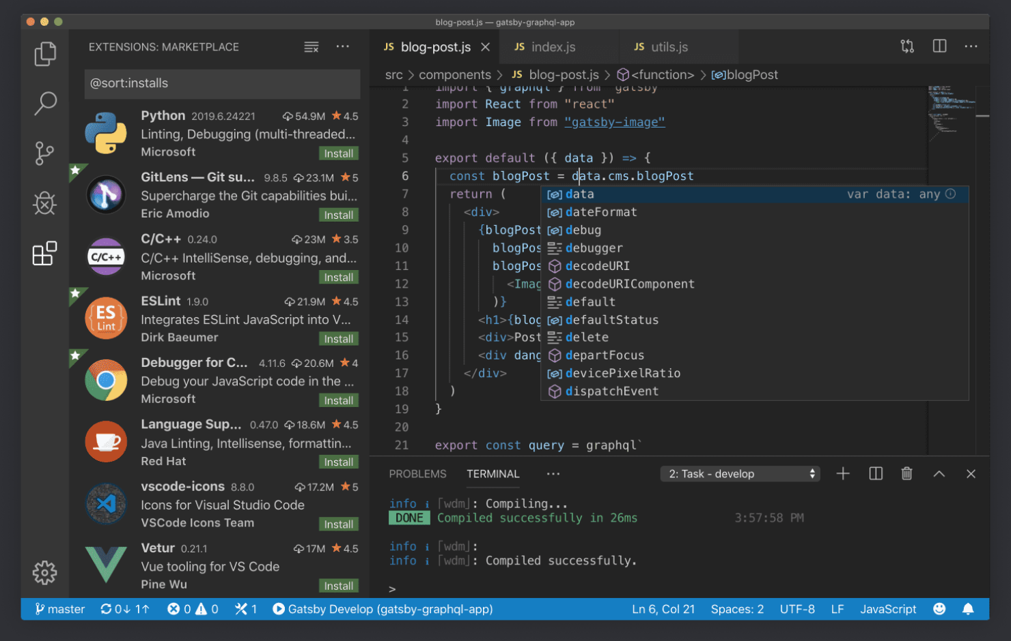
Installing Visual Studio Code
https://code.visualstudio.com
Once you have VSC installed, also install these extensions:
Azure Storage
Azure CLI
HTML Snippets
HTML CSS Support
Notes:
What is the difference between Visual Studio Code and Visual Studio IDE?
Visual Studio Code is a streamlined code editor with support for development operations like debugging, task running, and version control. It aims to provide just the tools a developer needs for a quick code-build-debug cycle and leaves more complex workflows to fuller featured IDEs, such as Visual Studio IDE.
Which OSs are supported?
VS Code runs on macOS, Linux, and Windows. See the Requirements documentation for the supported versions. You can find more platform specific details in the Setup overview.
Is VS Code free?
Yes, VS Code is free for private or commercial use. See the product license for details.

Slide 14
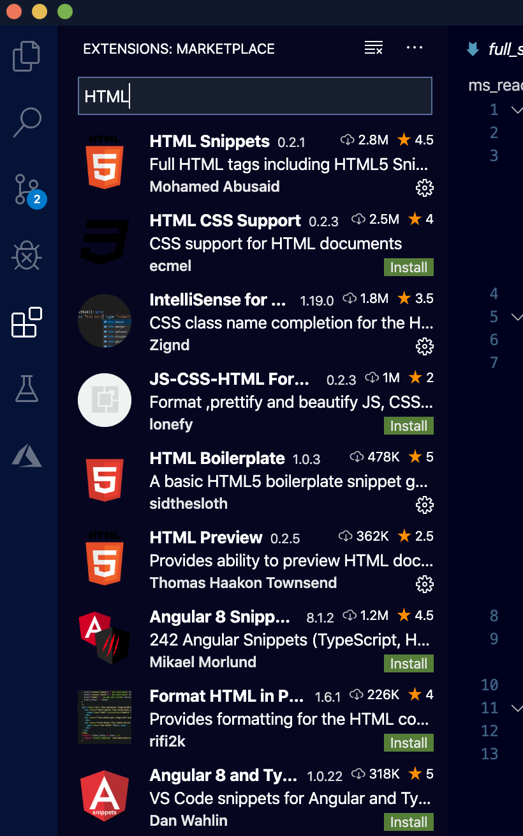
Adding Extensions to Visual Studio Code
2. Enter in the name of the extension here, or just start typing “HTML” or ”Azure” to see what is available.
1. Click here to see the extensions that can be installed.
3. Click the green “install” button to install the extension. Notice that if a ext. has a small gear, it is already installed.
Notes:
VSC has so many extensions it’s hard to know what to install. The good news is that installing and removing extensions is simple and you can try out different exts easily.
Be careful not to install too many at the same time, it could effect the performance of VSC causing lag or even hanging VSC up.
The rule of thumb that I follow is that I only install what I need.
Each extension is used differently, so you should read the documentation for each ext to learn how to use it.

Slide 15
HTML Overview: Basic Template
<!doctype html>
<html lang="en">
<head>
<meta charset="utf-8">
<title>The HTML5 Herald</title>
<meta name="description" content=”Your first HTML Page">
<meta name="author" content="SitePoint">
<link rel="stylesheet" href="css/styles.css?v=1.0">
</head>
<body>
<script src="js/scripts.js"></script>
</body>
</html>
Semantic HTML:
<header>
<section>
<form>
Non-Semantic HTML:
<img>
<div>
<p>
<span>
<input>
Notes:
*** Demo: Open up VSC and create a simple webpage from tags and discuss the tags as you build the page:
Go over HTML tags
Head * location in the HTML file where you can define attributes for a page
Title * Appears as the name of the webpage in the browser
Meta * various information that describes a webpage
Link * Linking other files like css and JS
Body * where the content of a webpage is held
Html * classifies the whole page
Discuss Sematic HTML: Semantic means, “meaning” or to give meaning.
A semantic element clearly describes its meaning to both the browser and the developer.
Examples of non-semantic elements: <div> and <span> - Tells nothing about its content.
Examples of semantic elements: <form>, <table>, and <article> - Clearly defines its content.
Fun fact and ?:
** HTML is recursive, why is it recursive?
** Who invented HTML? (Scientists at CERN Europe, who used it to classify and report their findings)

Slide 16
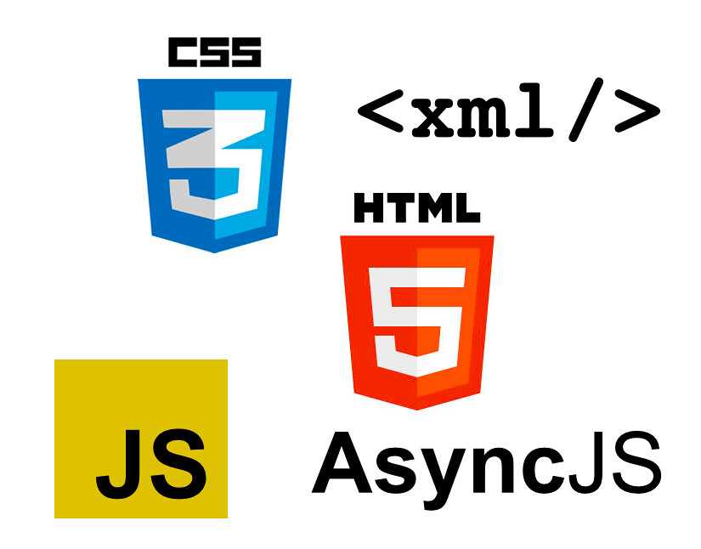
HTML Tips
Use Proper Document Structure
Constantly Validate Your Code!
Organize HTML Syntax
Avoid Using Too Many divs!
Make Use of Semantic Elements
Keep Your Tag Names Lowercase
Use alt Attribute With Images
Notes:
HTML is a language that allows poor code to execute and render to varying levels of accuracy. Successful rendering, however, does not mean that our code is correct or guarantee that it will validate as standards compliant. Poor code is unpredictable, and you can't be certain what you're going to get when it renders. We have to pay close attention when writing HTML and be sure to nest/indent and close all elements correctly and to always validate our code.
Use Proper Document Structure
Pages will render without the use of the <!DOCTYPE html> doctype or <html>, <head>, and <body> elements. However, without the doctype and these structural elements, pages will not render properly in every browser.
Constantly Validate Your Code!
While writing HTML, make a habit to validate frequently; this will save you from issues that are harder to pinpoint (or redo) once your work is completed and lengthier.
HTML validation services such as the free W3C Markup Validation Service are useful debuggers that help you identify rendering errors.
Organize HTML Syntax
As your HTML gets bigger, managing it can become quite a task. Below are quick rules that can help you keep your syntax clean and organized:
Use lowercase letters within element names, attributes, and values.
Indent nested elements.
Use double quotes, not single or completely omitted quotes to store in values for HTML attributes.
Avoid Using Too Many divs!
When writing HTML, it is easy to get carried away adding <div> elements here and there to build out necessary styles. While this works, it can add quite a bit of bloat to a page, and before too long we're not sure what each <div> element does.
Make Use of Semantic Elements
Deciding which elements to use to describe different content may be difficult, but these elements are the backbone of semantics.
Note: Semantic HTML is the use of HTML markup to reinforce the semantics, or meaning, of the information in webpages rather than merely to define its presentation or look. via: en.wikipedia.org/wiki/Semantic_HTMLHere the HTML doesn't use the proper heading and paragraph elements; instead, it uses meaningless elements to group content.
Keep Your Tag Names Lowercase
Technically, you can get away with capitalizing your tag names. Having said that, the best pra ctice is to keep all tags lowercase.
Use alt Attribute With Images (Not adding Alt tags is like discriminating a whole group of people who use screen readers)
Using meaningful alt attributes with <img> elements is a must for writing valid and semantic code. The alt information is helpful for when a user cannot view your image - whether due to a connection issue, a missing image, or because the user is utilizing a screen reader.

Slide 17
CSS – Cascading Style Sheets

Slide 18
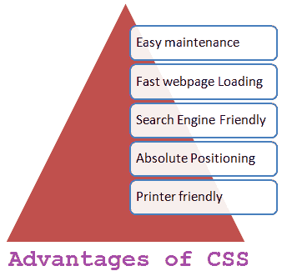
CSS Section Overview
CSS Selectors: id, class, tag
Styling Elements and Text
Using the Inspect Tool
Display Property and Box Model
Plotting Your Blocks

Slide 19
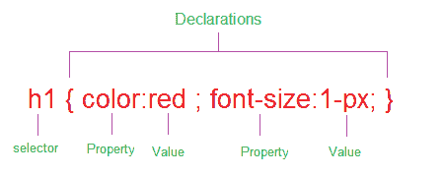
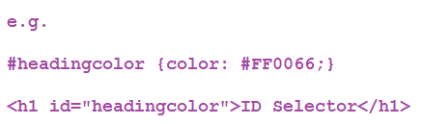
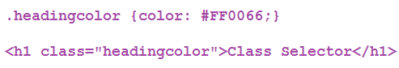
CSS Selectors
Selecting by #, . , <tag> (what’s the difference?)
Adding CSS to your webpages
CSS Priority/Specificity
CSS Resets/Libraries
Responsive?
Selecting by id and class
Notes:
*** Demo: Open VSC and connect the HTML page you created in the HTML section to a CSS file.
Discuss how to select HTML elements with class, id and tag.
ID selectors, Class selectors
The role of a selector is to tell the browser to which style is applied to a specific element in an HTML document. Selectors are patterns used to select the HTML tags that you want to style. These patterns may range from simple element names to rich contextual patterns.
ID selector
ID selectors in CSS allow you to target elements (Tags) by their ID values. ID selectors are unique, so you can apply only to the content of one element. To reference an ID, you precede the ID name with a hash mark (#).
Class selector
The Class selector in CSS , which references the class attribute used on HTML elements. The Class selector begins with a dot(.) and followed by a class name which you choose.
Explain CSS priority, it should be one of the first things you think about if you can’t “grab” an element and style it.

Slide 20
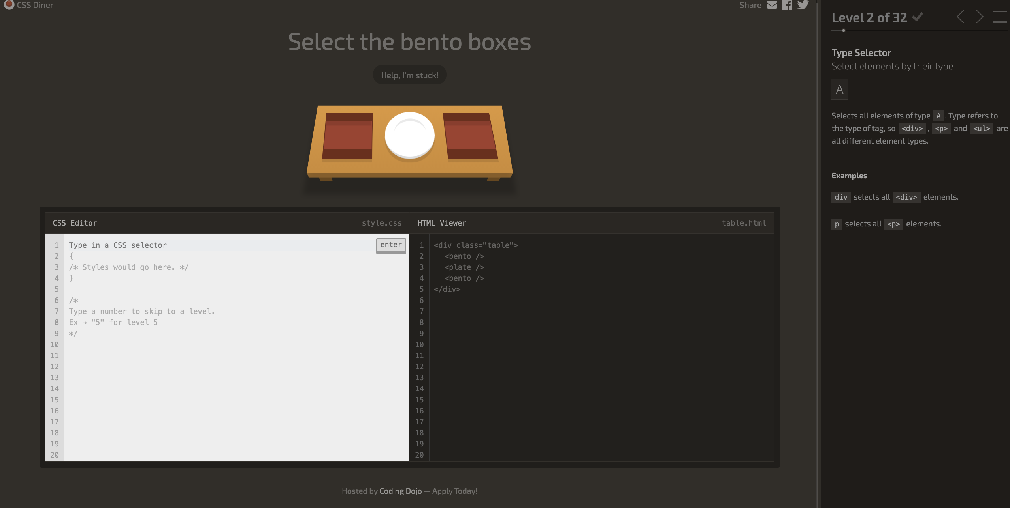
Activity: Dojo Diner
Notes:
This activity is to get students some practice with CSS Selectors. We are assuming that they know CSS already to some degree so feel free to breeze through the slides while they are starting the activity. You shouldn’t spend much time at all lecturing them on CSS. They should be learning by playing the game. If you have swag or something you can give the students who finish first some prizes.
Have students get together in groups no larger than 3 per group.
Bring up the site: Click Here to begin the activity.
It’s good to do the first couple for them so they can see the workflow.

Slide 21
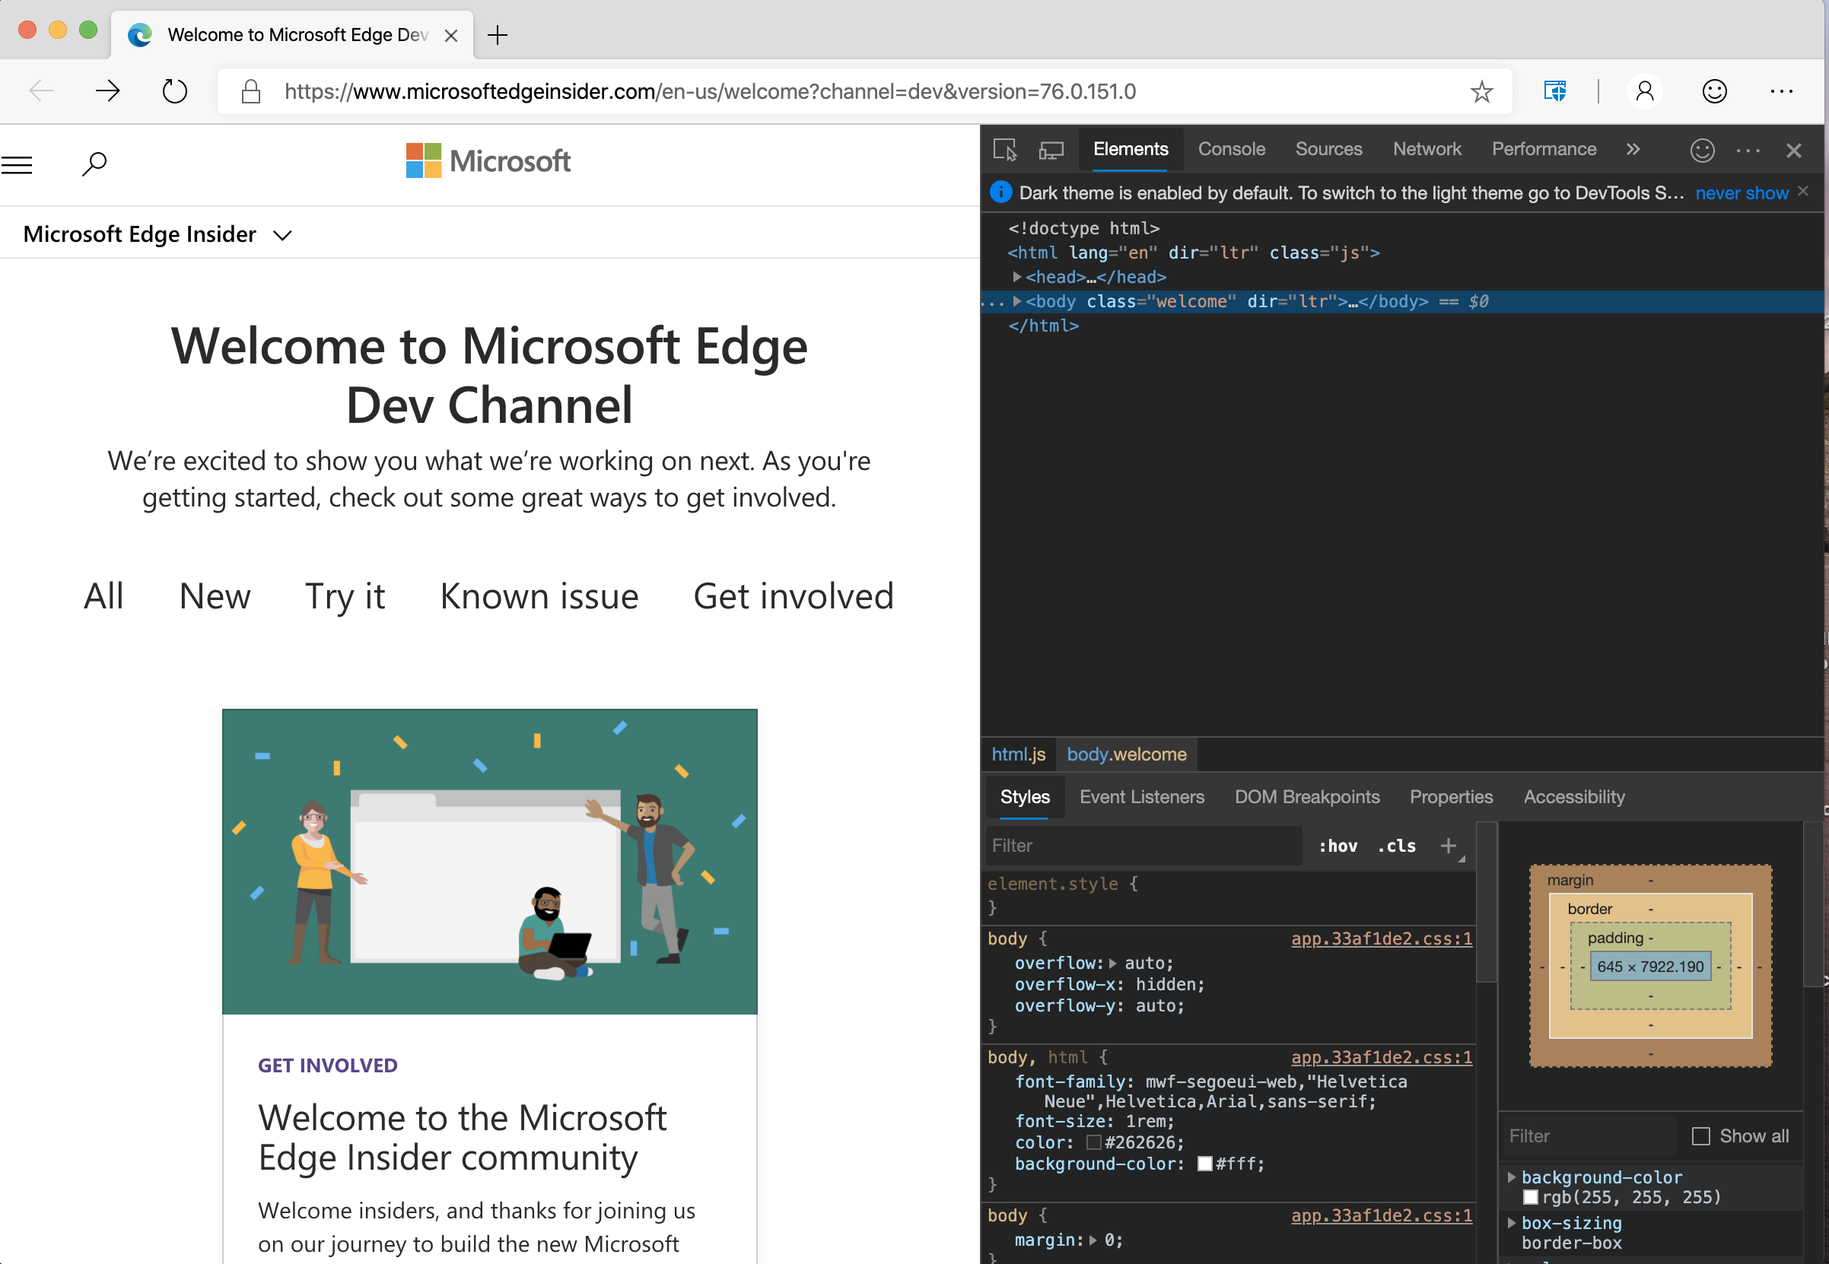
Using The Inspect Element Tool
Select individual elements
You can run JavaScript code in the console here.
Notes:
Explain how to access the Inspect tool: Here’s a resource for all the major browsers: https://www.lifewire.com/get-inspect-element-tool-for-browser-756549
Highlight the Console, and the specific element selection button.
Explain how you can change CSS here and “test” out how things will look, also getting sizes of elements is useful here.

Slide 22
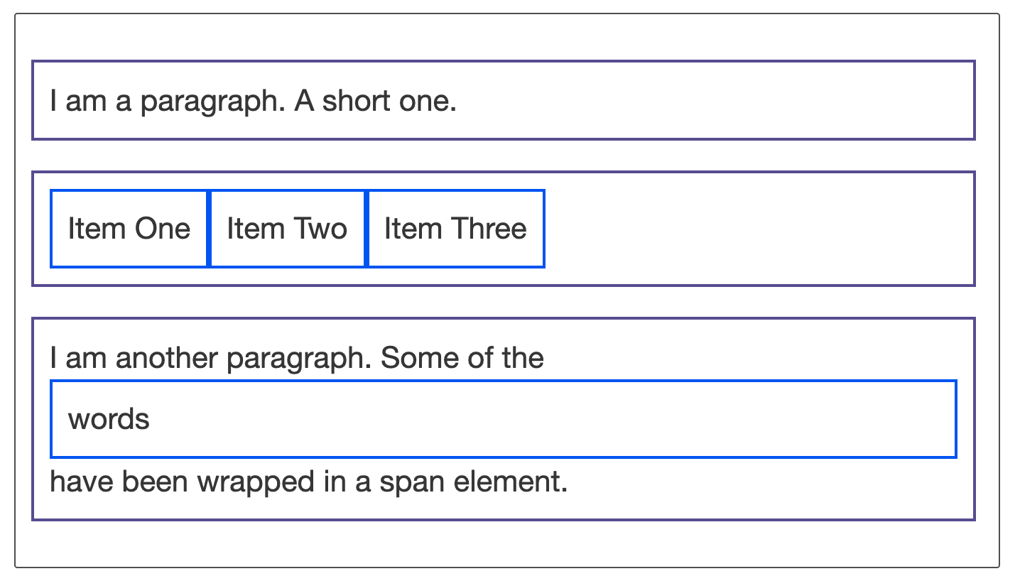
The Display Property
The display property specifies the display behavior (the type of rendering box) of an element.
Inline
Block
Flex
Grid
Click here to play with the code.
Notes:
In HTML, the default display property value is taken from the HTML specifications or from the browser/user default style sheet
Inline
Displays an element as an inline element (like <span>). Any height and width properties will have no effect
Block
Displays an element as a block element (like <p>). It starts on a new line, and takes up the whole width
Contents
Makes the container disappear, making the child elements children of the element the next level up in the DOM
Flex
Displays an element as a block-level flex container
Grid
Displays an element as a block-level grid container
Let's move on and have a look at some examples. Below we have three different HTML elements, all of which have an outer display type of block. The first is a paragraph, which has a border added in CSS. The browser renders this as a block box, so the paragraph begins on a new line, and expands to the full width available to it.
The second is a list, which is laid out using display: flex. This establishes flex layout for the items inside the container, however, the list itself is a block box and — like the paragraph — expands to the full container width and breaks onto a new line.
Below this, we have a block-level paragraph, inside which are two <span> elements. These elements would normally be inline, however, one of the elements has a class of block, and we have set it to display: block.
Open this pen and go over the code for the image above: https://codepen.io/dannyooooo/pen/Powybqr

Slide 23
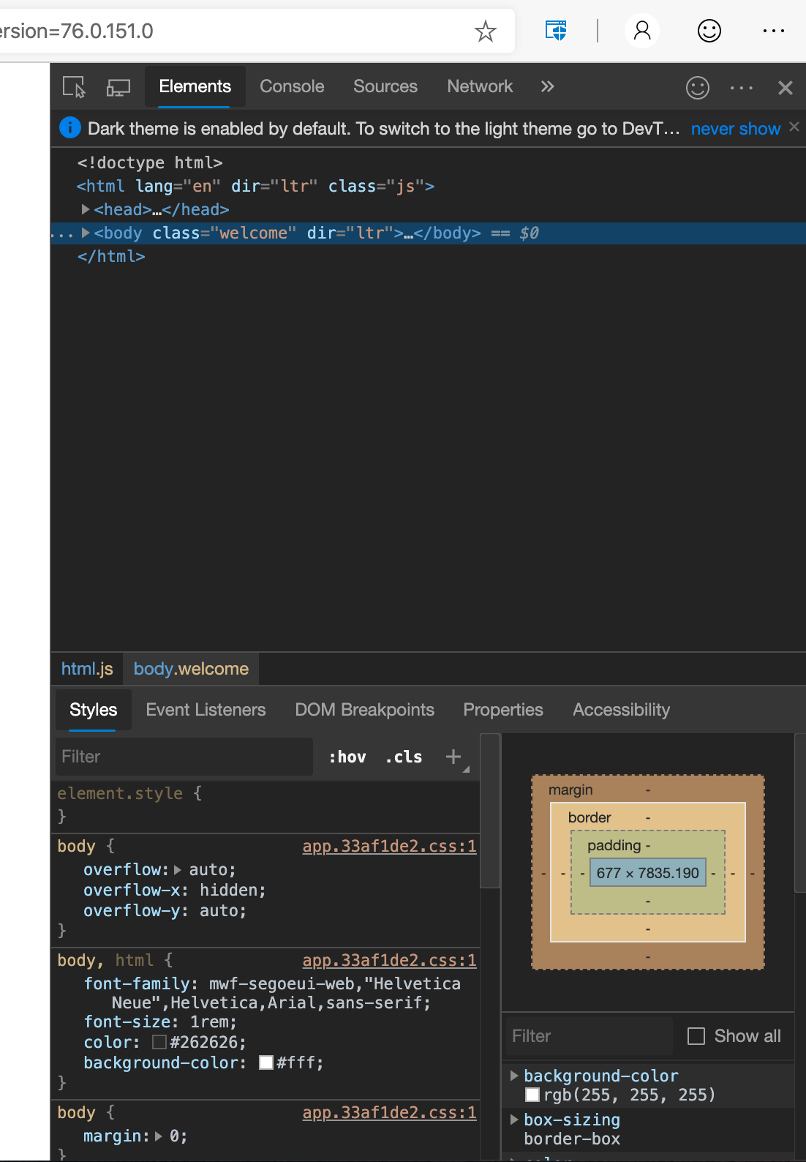
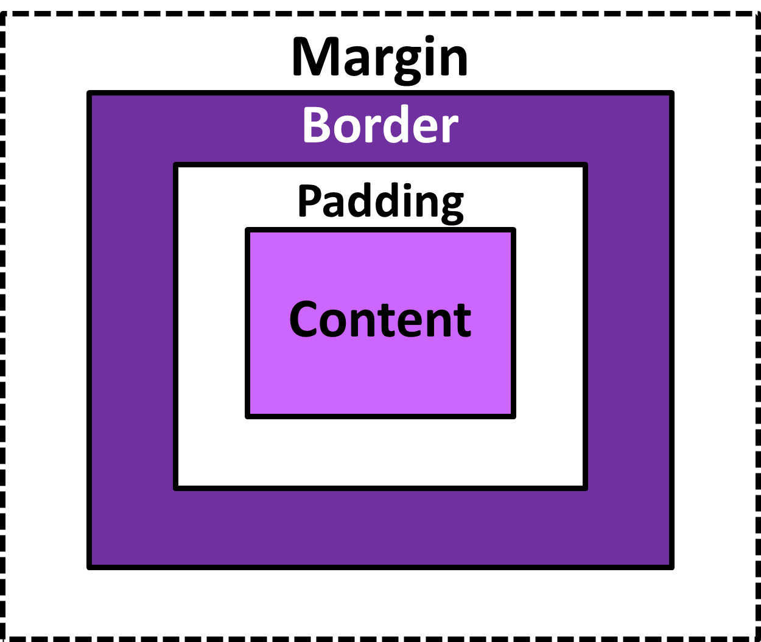
Box Model
Box Model
In Inspect Element
Notes:
Great resource for the box model: https://learn.shayhowe.com/html-css/opening-the-box-model/
*** Demo Open this activity and play with code: https://codepen.io/dannyooooo/pen/zYxmoBP
Play with margins and padding.
Explain how to adjust in Inspect Element tool.
Ask about the differences
Show the code with and without “outline: 1px solid green” and explain why outline is useful as a way to see all your elements and how they are overlapping or not.
CSS Outline
An outline is a line that is drawn just outside the border edge of the elements such as buttons, active form fields, etc., to make them stand out.
Outlines Vs Borders
The outlines are generally used to highlight elements. An outline at a glance looks very similar to the border, but it differs from border in the following ways:
Outlines do not take up space, because they always placed on top of the box of the element which may cause them to overlap other elements on the page.
Unlike borders, outlines won't allow us to set each edge to a different width, or set different colors and styles for each edge. An outline is the same on all sides.
Outlines don't have any impact on surrounding elements apart from overlapping.
Unlike borders, outlines don't change the size or position of the element.
Outlines may be non-rectangular.

Slide 24

Activity Create a Static Webpage: Portfolio
Notes:
You can bring up this website here: https://codepen.io/dannyooooo/pen/feb419a81bfc3431f78435120eeb30e8 and demo it for the students if they are getting stuck or you’ve run out of time.

Slide 25
Please take a moment to complete this survey. Survey: https://aka.ms/ReactorFeedback

Slide 26
Quick JavaScript Overview

Slide 27
JavaScript Overview
Intro to JavaScript
JSBin & running JS in the console
JavaScript Functions
An intro to JavaScript Objects

Slide 28

Introduction to JavaScript
Written in less than 2 weeks!
Microsoft adopted JS in 1996 to support IE 3
The language in the browser
HTML vs JavaScript
Notes:
Talk about how JS was written by Brendan Eich when he was working at Netscape. The rumor is that he wrote it in 11 days.
JavaScript is the programming language of HTML and the Web.
JavaScript is a programming language used to make web pages interactive. It is what gives a page life—the interactive elements and animation that engage a user. If you've ever used a search box on a home page, checked a live baseball score on a news site, or watched a video, it has likely been produced by JavaScript.
Javascript (JS) is a scripting languages, primarily used on the Web. It is used to enhance HTML pages and is commonly found embedded in HTML code. JavaScript is an interpreted language. Thus, it doesn't need to be compiled. JavaScript renders web pages in an interactive and dynamic fashion. This allowing the pages to react to events, exhibit special effects, accept variable text, validate data, create cookies, detect a user’s browser, etc.
JavaScript is easy to learn.
JavaScript Can Change HTML Content
A JavaScript function is a block of JavaScript code, that can be executed when "called" for.
For example, a function can be called when an event occurs, like when the user clicks a button.
HTML Versus JavaScript
HTML and JavaScript are complementary languages. HTML is a markup language designed for defining static webpage content. It is what gives a webpage its basic structure. JavaScript is a programming language designed for performing dynamic tasks within that page, like animation or a search box.
JavaScript is designed to run within the HTML structure of a website and is often used multiple times. If you're writing code, your JavaScript will be more easily accessible if placed them in separate files (using a .JS extension helps identify them). You then link the JavaScript to your HTML by inserting a tag

Slide 29
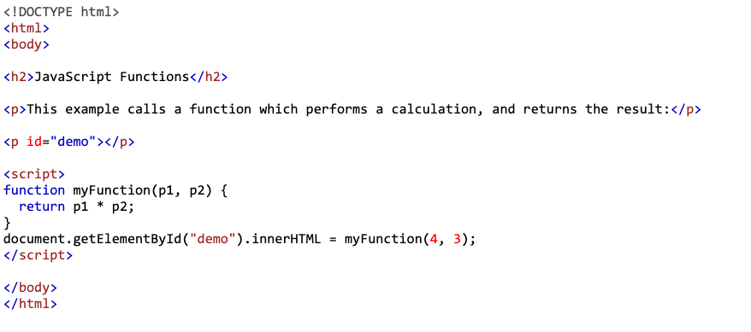
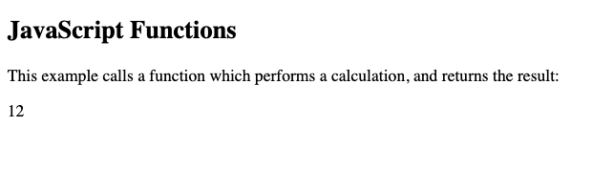
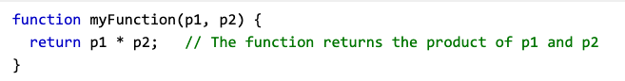
Using JavaScript Functions
A JavaScript function is a block of code designed to perform a particular task.
A JavaScript function is executed when "something" invokes it (calls it).
Running JS in your browser console and places like JSBin and Codepen
Notes:
Walk them through the example above,
*** Demo: Open JSBin and run each of the 13 functions there. Have the students predict out loud what they think the output of each statement. https://jsbin.com/casegoy/edit?js,console

Slide 30

The Document Object Model
DOM vs Source Code?
JavaScript to manipulate the DOM
DOM makes dynamic pages possible
Notes:
Start with explaining the difference between the source code of a webpage and the DOM
We use Javascript to change the DOM on a webpage so we don’t have to reload the page each time someone clicks on something
The Document Object Model (DOM) connects web pages to scripts or programming languages by representing the structure of a document—such as the HTML representing a web page—in memory. Usually that means JavaScript, although modeling HTML, SVG, or XML documents as objects is not part of the JavaScript language, as such.
The DOM represents a document with a logical tree. Each branch of the tree ends in a node, and each node contains objects. DOM methods allow programmatic access to the tree; with them you can change the document's structure, style, or content. Nodes can also have event handlers attached to them; once an event is triggered, the event handlers get executed.
The Document Object Model (DOM) is a programming interface for HTML and XML documents. It represents the page so that programs can change the document structure, style, and content. The DOM represents the document as nodes and objects. That way, programming languages can connect to the page.
A Web page is a document. This document can be either displayed in the browser window or as the HTML source. But it is the same document in both cases. The Document Object Model (DOM) represents that same document so it can be manipulated. The DOM is an object-oriented representation of the web page, which can be modified with a scripting language such as JavaScript.
Wikipedia:
The Document Object Model (DOM) is a cross-platform and language-independent interface that treats an XML or HTML document as a tree structure wherein each node is an object representing a part of the document. The DOM represents a document with a logical tree. Each branch of the tree ends in a node, and each node contains objects. DOM methods allow programmatic access to the tree; with them one can change the structure, style or content of a document. Nodes can have event handlers attached to them. Once an event is triggered, the event handlers get executed.

Slide 31
Using jQuery and APIs

Slide 32
jQuery/API Overview
Introduction to jQuery and APIs
Using jQuery to access APIs
Combining HTML and jQuery
Creating a Pokedex
Notes:
Explain that this is just to get some exposure to jQuery so that they can create a pokedex.
Code will be provided for this section.

Slide 33
jQuery usage
Making sure jQuery is in your <head>
Basic syntax is: $(selector).action()
webpage.net
1. User clicks button (the selector)
2. jQuery .hide() function is triggered and the element disappears
BUTTON
Notes:
*** Demo: With jQuery you select (query) HTML elements and perform "actions" on them.
jQuery is a fast, small, and feature-rich JavaScript library. It makes things like HTML document traversal and manipulation, event handling, animation, and Ajax much simpler with an easy-to-use API that works across a multitude of browsers. With a combination of versatility and extensibility, jQuery has changed the way that millions of people write JavaScript.
Open an editor and review jQuery Syntax. The jQuery syntax is tailor-made for selecting HTML elements and performing some action on the element(s).
Here is a codepen loaded with a demo of .hide and .get
https://codepen.io/dannyooooo/pen/ExaOjEQ
A $ sign to define/access jQuery
A (selector) to "query (or find)" HTML elements
A jQuery action() to be performed on the element(s)
Examples:
$(this).hide() - hides the current element.
$("p").hide() - hides all <p> elements.
$(".test").hide() - hides all elements with class="test".
$("#test").hide() - hides the element with id="test".

Slide 34
jQuery usage
Making sure jQuery is in your <head>
Basic syntax is: $(selector).action()
webpage.net
1. User clicks button (the selector)
2. jQuery .hide() function is triggered and the element disappears
BUTTON
Notes:
*** Demo: With jQuery you select (query) HTML elements and perform "actions" on them.
jQuery is a fast, small, and feature-rich JavaScript library. It makes things like HTML document traversal and manipulation, event handling, animation, and Ajax much simpler with an easy-to-use API that works across a multitude of browsers. With a combination of versatility and extensibility, jQuery has changed the way that millions of people write JavaScript.
Open an editor and review jQuery Syntax. The jQuery syntax is tailor-made for selecting HTML elements and performing some action on the element(s).
Here is a codepen loaded with a demo of .hide and .get
https://codepen.io/dannyooooo/pen/ExaOjEQ
A $ sign to define/access jQuery
A (selector) to "query (or find)" HTML elements
A jQuery action() to be performed on the element(s)
Examples:
$(this).hide() - hides the current element.
$("p").hide() - hides all <p> elements.
$(".test").hide() - hides all elements with class="test".
$("#test").hide() - hides the element with id="test".

Slide 35
API: Application Programming Interface
Connected Car
Connected Phone
Your
Company
API
Enterprise App
Tablet
Camera at Site
Notes:
Demo: Start by talking about APIs:
What is an API? – The term API is an acronym, and it stands for “Application Programming Interface.”
What are some examples of APIs?
What are some examples of APIs that aren’t code based? (Is a keyboard and API? Is your screen on your phone and API? The point is that an API is something that we use to interact with machines with computers in them)
Application Programming Interface
Think of an API like a menu in a restaurant. The menu provides a list of dishes you can order, along with a description of each dish. When you specify what menu items you want, the restaurant’s kitchen does the work and provides you with some finished dishes. You don’t know exactly how the restaurant prepares that food, and you don’t really need to.
Similarly, an API lists a bunch of operations that developers can use, along with a description of what they do. The developer doesn’t necessarily need to know how, for example, an operating system builds and presents a “Save As” dialog box. They just need to know that it’s available for use in their app.
This isn’t a perfect metaphor, as developers may have to provide their own data to the API to get the results, so perhaps it’s more like a fancy restaurant where you can provide some of your own ingredients the kitchen will work with.
But it’s broadly accurate. APIs allow developers to save time by taking advantage of a platform’s implementation to do the nitty-gritty work. This helps reduce the amount of code developers need to create, and also helps create more consistency across apps for the same platform. APIs can control access to hardware and software resources.
We are going to build a program that goes out to the pokedex API and returns information in the form of JSON.
The jQuery get() and post() methods are used to request data from the server with an HTTP GET or POST request.
HTTP Request: GET vs. POST
Two commonly used methods for a request-response between a client and server are: GET and POST.
GET - Requests data from a specified resource
POST - Submits data to be processed to a specified resource
GET is basically used for just getting (retrieving) some data from the server.
POST can also be used to get some data from the server. However, the POST method NEVER caches data, and is often used to send data along with the request.
jQuery $.get() Method
The $.get() method requests data from the server with an HTTP GET request. Show the example above.

Slide 36
Capstone Project: Building a Pokedex

Slide 37
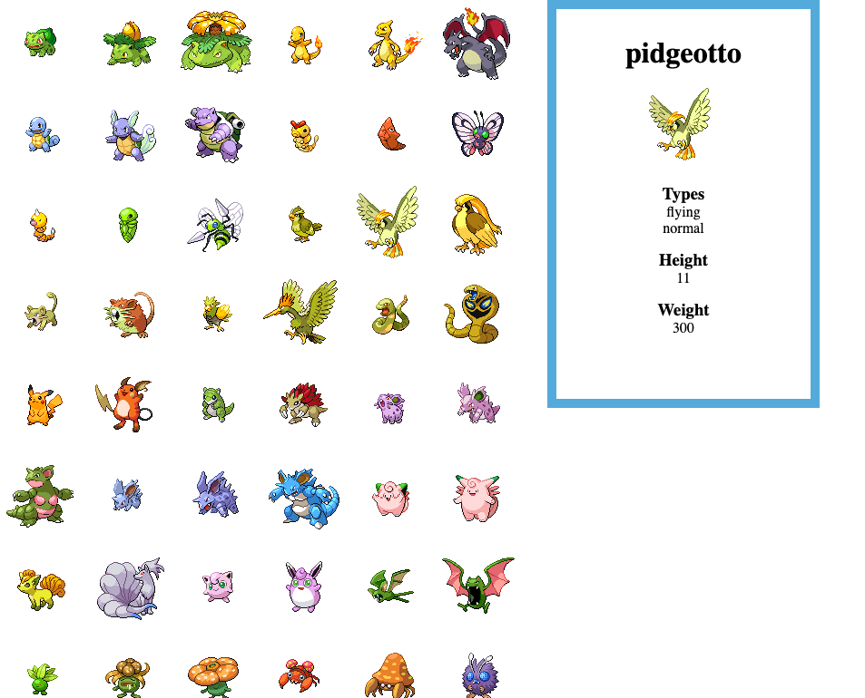
Capstone Project: Building a Pokedex
Notes:
Here is the working code: https://codepen.io/dannyooooo/pen/229e50320ec54d6b8e2f845fa07672ba
The code is also in the Instructor’s materials.
*** Demo do a walk through on the code after the students have struggled with it for a while.

Slide 38
Share your portfolio sites! Questions?
Notes:
Over the past two decades, web development has emerged as a profession due to the fact that we have powerful computers that we can work with at our homes and offices.
The development of supporting technologies have furthered the proliferation of the internet and made the web ubiquitous.

Slide 39
Additional Learning Resources and Next Steps

Slide 40
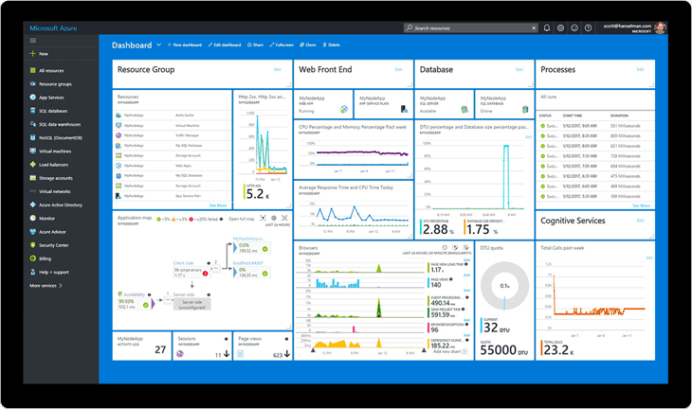
Free Azure for your next experiment…
azure.microsoft.com/free/
azure.microsoft.com/free/students/
Notes:
https://azure.microsoft.com/free/
Pros: $200 for 30 days + Always Free Tier
https://azure.microsoft.com/free/students/
Students: $100 for 12 months + Always Free Tier

Slide 41
Further Learning in Web Development on Azure…
Microsoft Learn has free learning in a cloud sandbox:
Azure Fundamentals - https://docs.microsoft.com/en-us/learn/paths/azure-fundamentals/
Deploy a Website with Azure Virtual Machines - https://docs.microsoft.com/en-us/learn/paths/deploy-a-website-with-azure-virtual-machines/)
C#: First Steps - https://docs.microsoft.com/en-us/learn/paths/csharp-first-steps/
Deploy a website with Azure App Service - https://docs.microsoft.com/en-us/learn/paths/deploy-a-website-with-azure-app-service/
/

Slide 42

Role-based Microsoft certs for development:
Microsoft Certified Solutions Associate
Microsoft Certified Solutions Developer (MCSD)
Microsoft Certified: Azure Developer Associate
Azure Fundamentals

Slide 43
developer.microsoft.com/reactor/
@MSFTReactor on Twitter
Notes:
Thank you!

Slide 44
© 2019 Microsoft Corporation. All rights reserved. The text in this document is available under the Creative Commons Attribution 3.0 License, additional terms may apply. All other content contained in this document (including, without limitation, trademarks, logos, images, etc.) are not included within the Creative Commons license grant. This document does not provide you with any legal rights to any intellectual property in any Microsoft product. You may copy and use this document for your internal, reference purposes.
This document is provided "as-is." Information and views expressed in this document, including URL and other Internet Web site references, may change without notice. You bear the risk of using it. Some examples are for illustration only and are fictitious. No real association is intended or inferred. Microsoft makes no warranties, express or implied, with respect to the information provided here.

Slide 45
Capstone project

